Slide 1

EDA Bank Credit Case Study
By: Abhishek Jain
Neethu Maria Tom

Slide 2
Problem Statement
Loan providing company wants to understand the driving factors behind loan default, i.e. the variables which are strong indicators of default. Two types of risks are associated with the bank’s decision:
• If the applicant is likely to repay the loan, then not approving the loan results in a loss of business to the company
• If the applicant is not likely to repay the loan, i.e. he/she is likely to default, then approving the loan may lead to a financial loss for the company.

Slide 3
Analysis Approach
Analysis approach focuses on identifying key factors/variables that could possibly influence a loan applicant to be a defaulter or not. These insights can help bank to approve or reject applicants.
This analysis also aims to identify top correlations between the available data variables.
Steps followed for analysis:
Null values and outliers were identified , handled and sufficient data cleaning was performed.
Created new columns for easy analysis when needed.
Found out imbalance in the data.
Derived insights after conducting univariate, bivariate and multivariate analysis.

Slide 4





Steps carried out in EDA for Credit Case Study
Data Understanding Data Cleaning Data Analysis(Univariate/Bivariate)
Correlation Analysis Insights & Conclusions

Slide 5
Data Understanding
Applicant Demographics | Loan related information
AMT_INCOME_TOTAL | AMT_CREDIT
CODE_GENDER
NAME_FAMILY_STATUS | AMT_ANNIUTY
NAME_EDUCATION_TYPE
REG_CITY_NOT_LIVE_CITY | AMT_GOODS_PRICE
ORGANIZATION_TYPE
NAME_INCOME_TYPE | NAME_CONTRACT_TYPE
OCCUPATION_TYPE

Slide 6
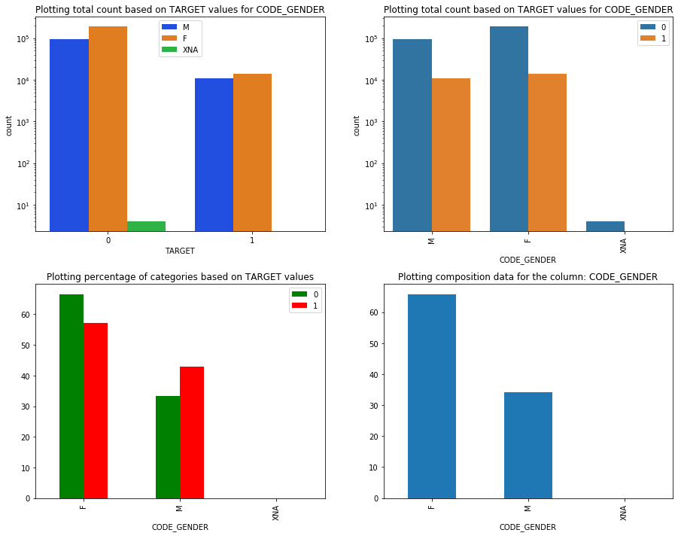
Association of variable gender with TARGET
There are nearly twice female applicants
than male applicants. Even though there
are defaulters from both genders
proportional to the gender counts, male applicants tend to default more than female applicants as count of defaulters for male and females are nearly same.

Slide 7
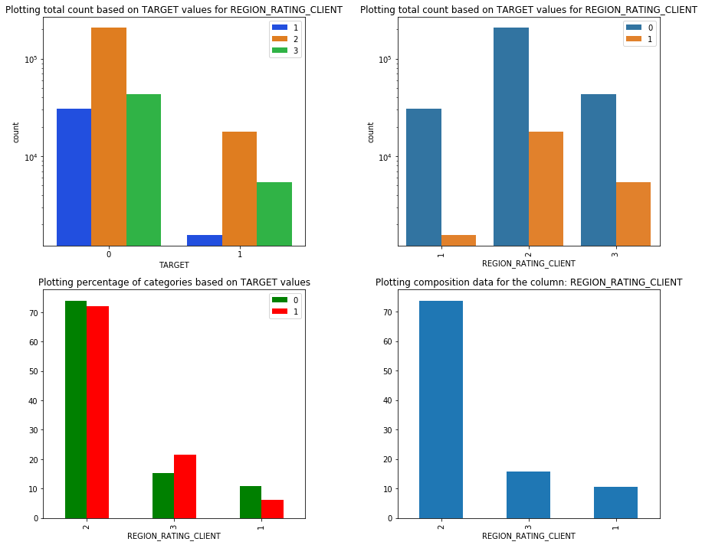
Association of variable REGION_RATING_CLIENT with TARGET.
Clients from Region2 seems to be availing and getting more loans. People from region with rating 3 have high default percentage.
Less number of people default from region rated 1.

Slide 8
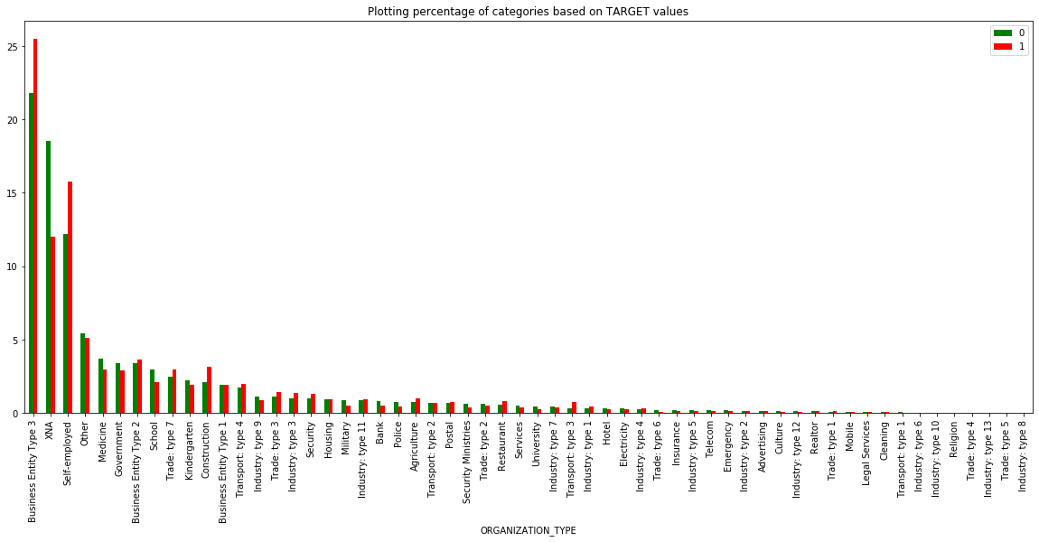
Association of variable ORGANIZATION_TYPE with TARGET.
In the ORGANIZATION_TYPE column, Business Entity Type 3 and Self-employed tend to be having high default percentage. Even though applicants from construction organization are less, it also has considerable defaulters.

Slide 9
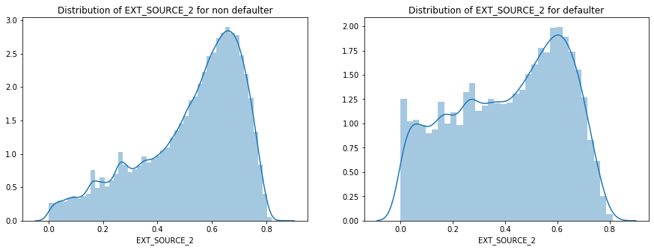
Association of variable EXT_SOURCE_2 with TARGET.
In case of EXT_SOURCE_2 score non-defaulter’s distribution, number of applicants with score between 0 and 0.3 are high compared to defaulters. This means that applicants with score <0.3 has higher chance to default.

Slide 10
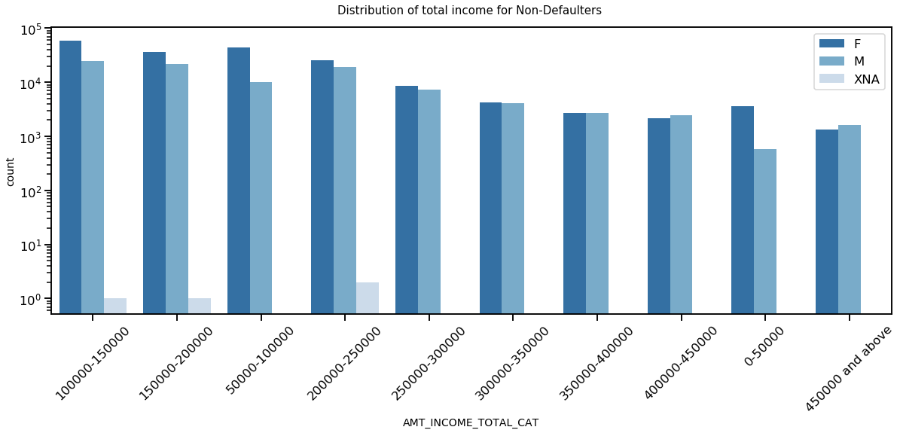
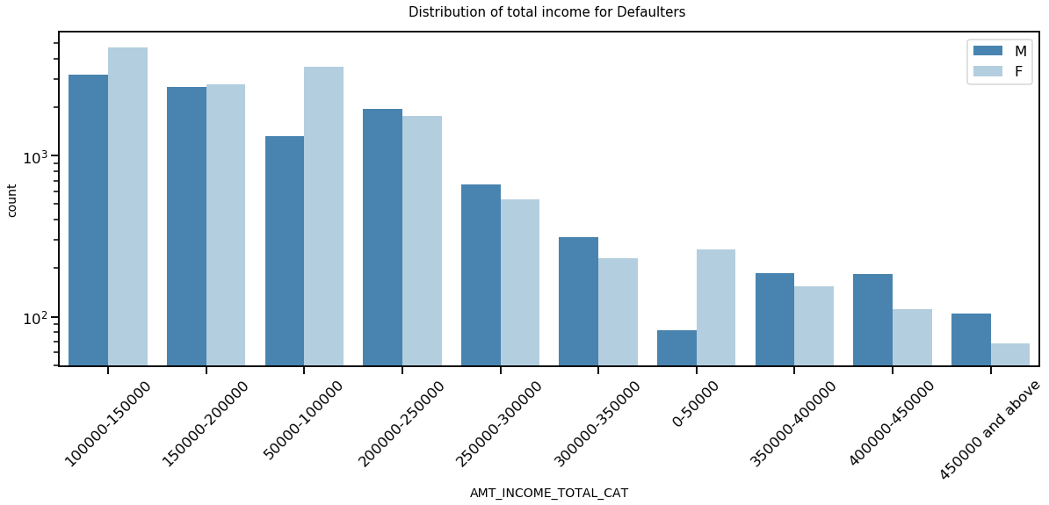
Income distribution for Defaulters and Non-Defaulters
Defaulters:
For Defaulters, Female counts are nearly equal for most of the
categories as compared to male.
Income range from 100000 to 150000 is having a greater counts.
Lowest counts in the income ranges for males and females in
above 450000.
Non-Defaulters:
For Non-Defaulters, Female counts are higher than male.
Income range from 100000 to 150000 is having higher income.
Female applicants have more income in almost all ranges than male applicants

Slide 11
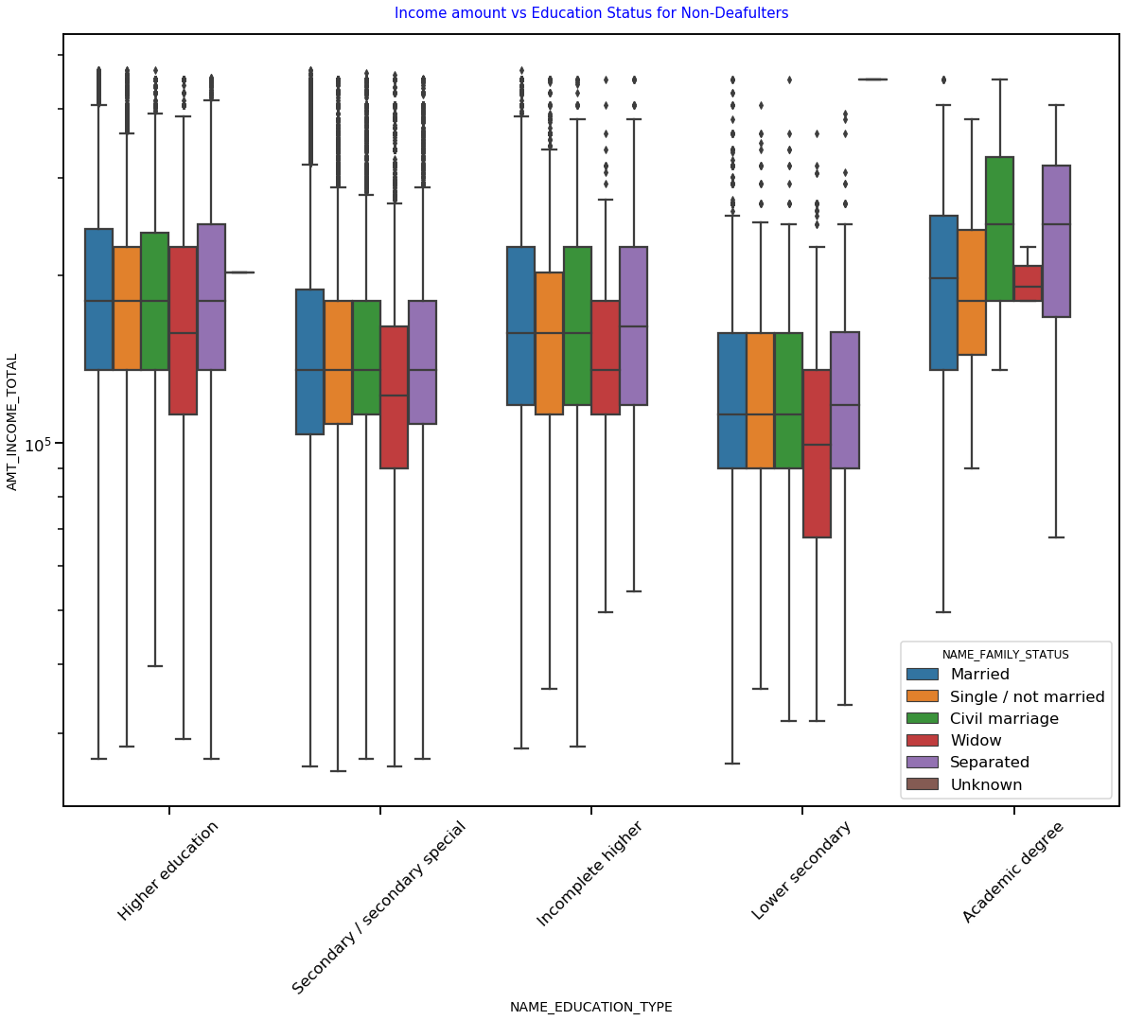
Analysis for income vs education status for non-defaulters
1.Least number of outliers in income are present for applicants with Academic degree & the median income is mostly higher than that of all other education categories.
2.When compared to others, people with Lower secondary education and widow status have less income amount.
3.Except for Academic degree holders, in all other education categories, median income is almost same for all family statuses with widow as an exception.

Slide 12
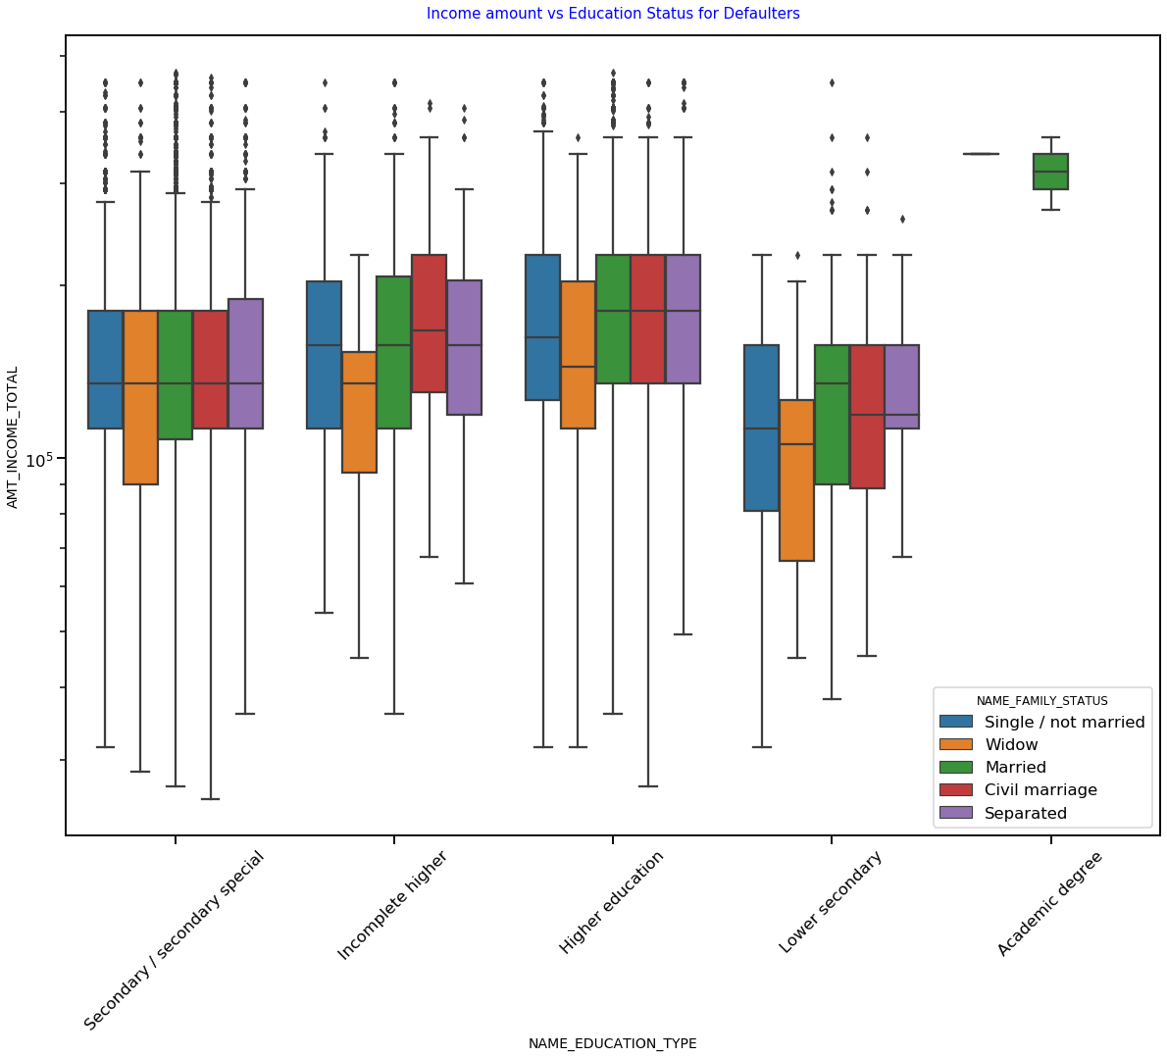
Analysis for income vs education status for defaulters
1. People with Academic degree tend to default less. Even then married people with academic category defaults.
2. The income amount is higher for Academic degree than Higher education with minimum number of outliers.
3. Lower secondary have less income amount than others.
4. More number of outliers are present for Married status people who are secondary/ secondary special qualified.

Slide 13
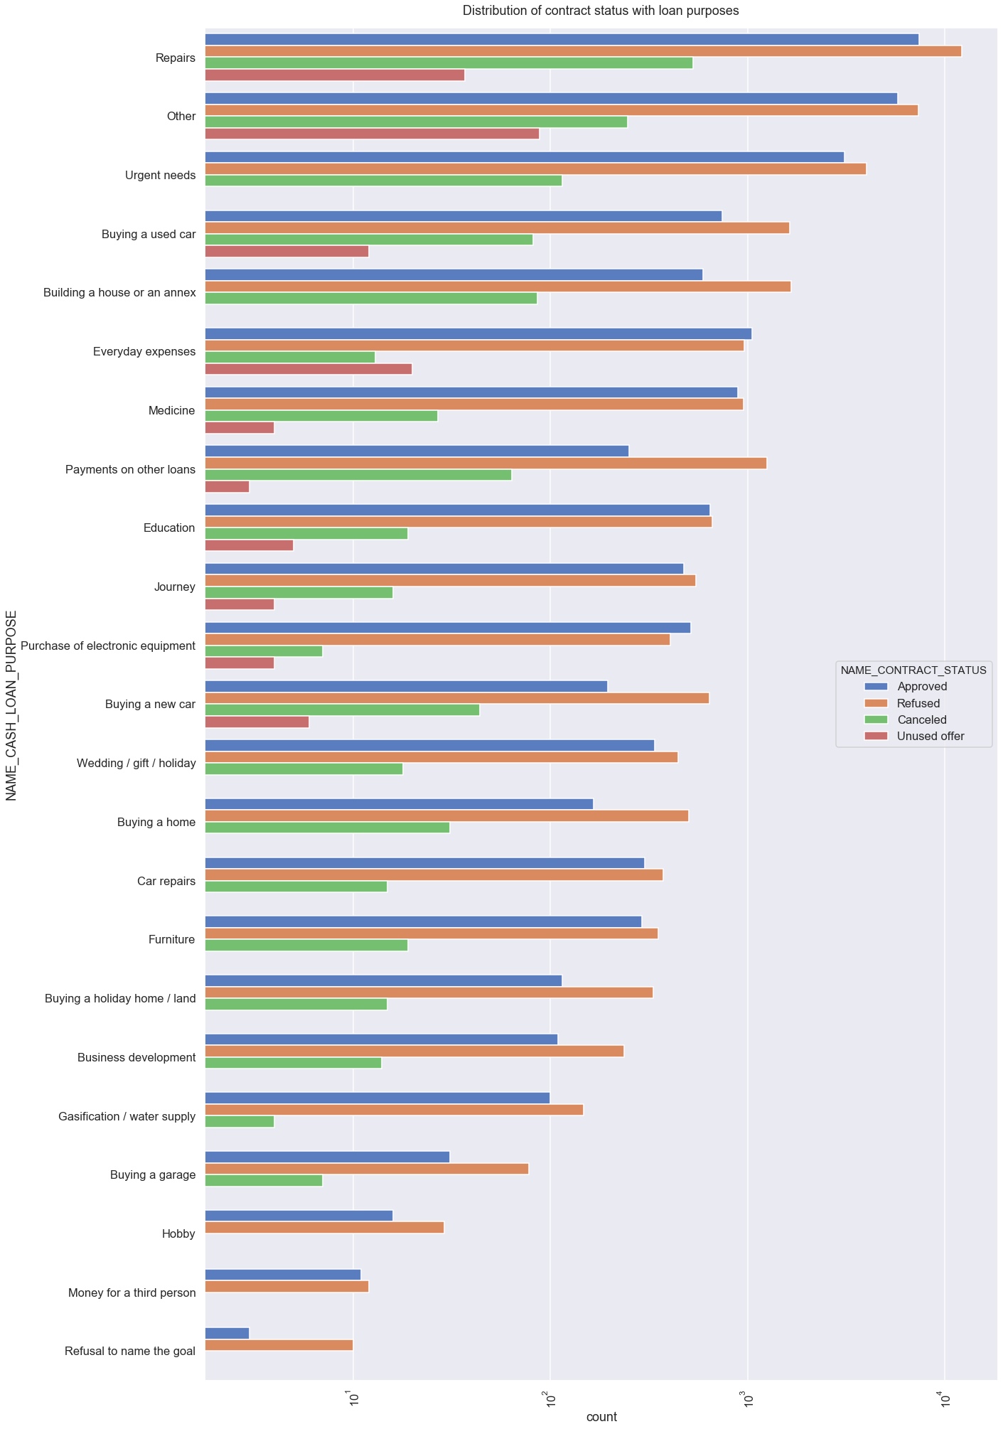
Distribution of Loan Purpose hued to contract status
Inferences:
In almost all categories of loan purpose, most of the loans were rejected by the bank except for education, everyday expense, purchase of electronic equipment.
Mostly applicants has cancelled a loan applied for buying something, urgent needs and repairs.
There are equal number of approvals & refusals in “Education” loan requests
When the applicant refuses to name the goal of taking loan, bank mostly rejects it.
Around 10000 requests for “Repair” type loans and “Payment on other loans” have been refused & holds highest rejections.

Slide 14
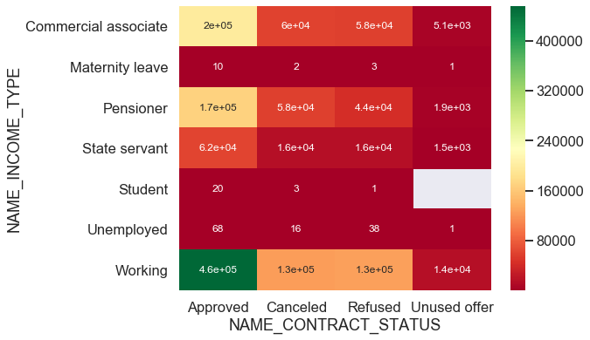
Relation between loan status and income type
Loans contract status shows that mostly status are approved for working, commercial associate and pensioner
Rejections are also higher in case of working, commercial associate and pensioner. Approvals are more than that of rejections
People from Students, unemployed and maternity leave categories apply least number of loans

Slide 15
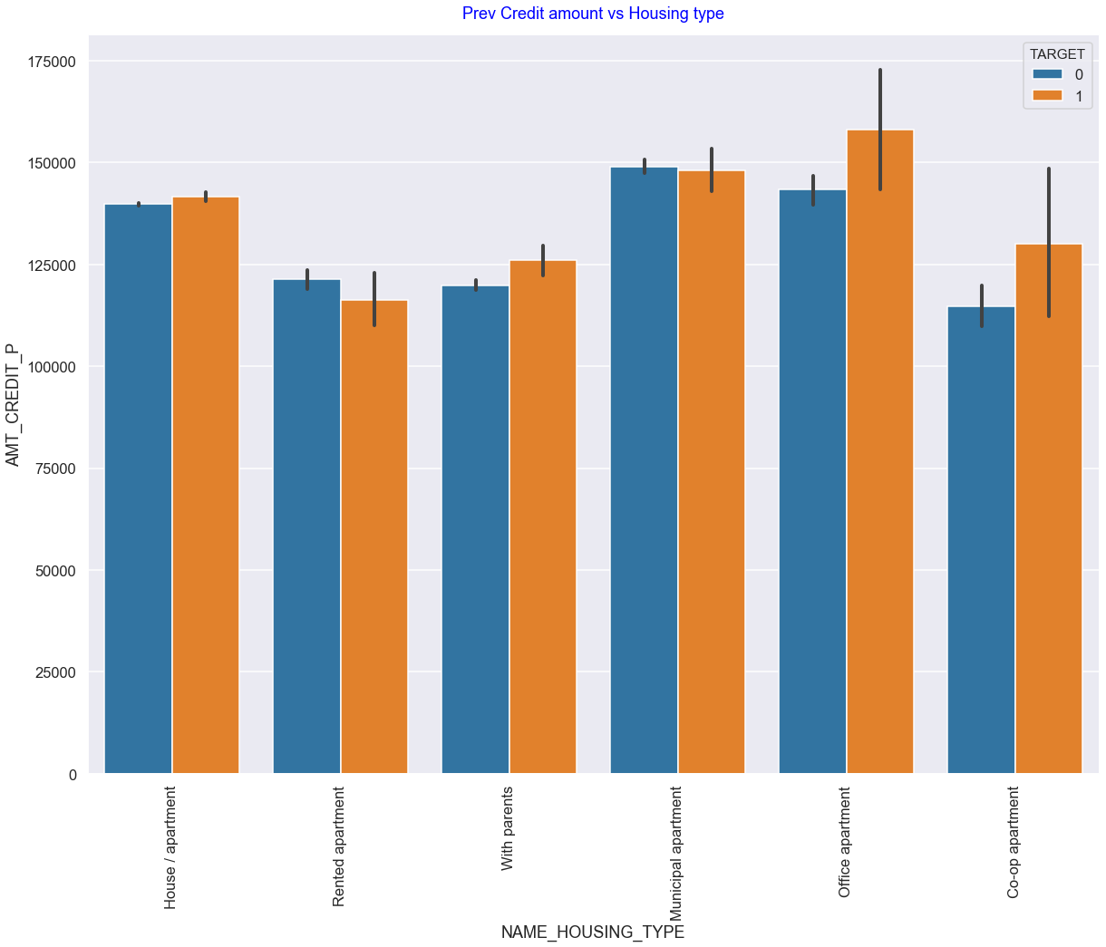
Relation between housing type and amount credited with the target variable
1. Bank must be careful when giving credit to housing types, with parents, office apartment and co-op apartment. Among those categories default applicants has high credit than non-defaulters.
2. Mean credit amount for House/apartment, municipal apartment for both defaulters and non defaulters are the similar.

Slide 16
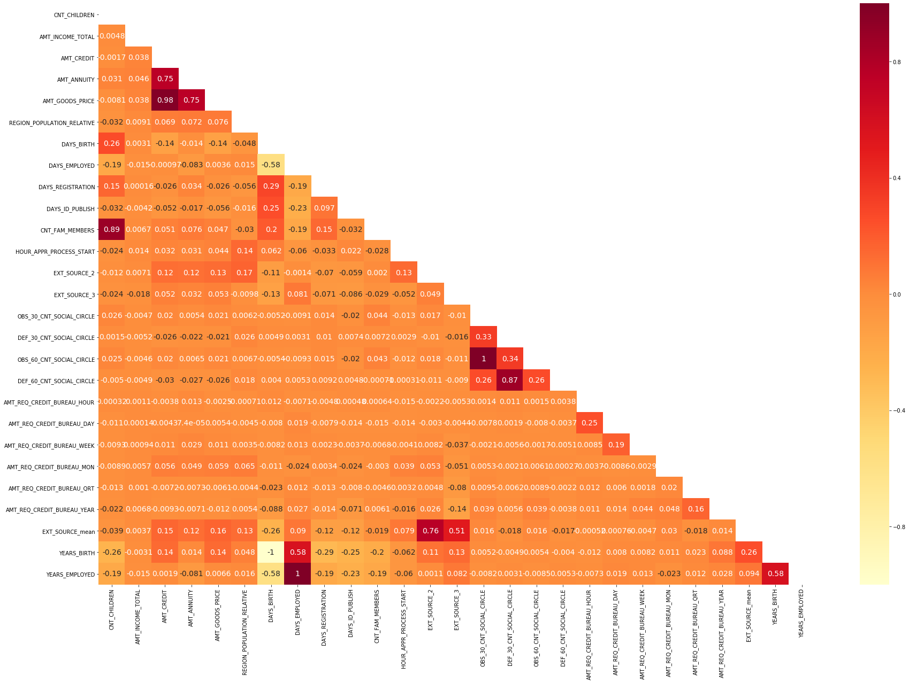
Correlation between variables leading to Loan Defaulters & Non-Defaulters:
When AMT_CREDIT,AMT_ANNUITY, AMT_GOODS_PRICE had a correlation greater than 0.3 with AMT_INCOME_TOTAL in case of non-defaulters, it is less than 0.04 in case of defaulters. This could mean that for defaulters even if AMT_INCOME_TOTAL increases, there will not be a corresponding increase in AMT_CREDIT,AMT_ANNUITY,AMT_GOODS_PRICE.
Similar to non-defaulter’s correlation, in case of defaulters also AMT_CREDIT has high correlation with AMT_ANNUITY and AMT_GOODS_PRICE.
In case of correlation between DAYS_EMPLOYED and DAYS_BIRTH, it is less for defaulters compared to non-defaulters.
EXT_SOURCE_mean has slight correlation with AMT_CREDIT,AMT_ANNUITY,AMT_GOODS_PRICE, REGION_POPULATION_RELATIVE and DAYS_BIRTH for both defaulters and non-defaulters.
OBS_30_CNT_SOCIAL_CIRCLE and OBS_60_CNT_SOCIAL_CIRCLE has a correlation coefficient of one, which could mean that both variables contain exactly same data.or it could mean that with in 60 days of duration data is not changing for a same social circle

Slide 17
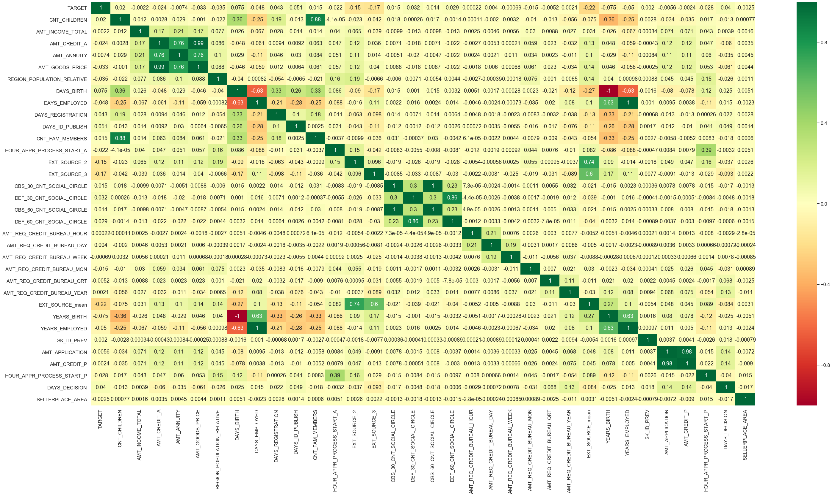
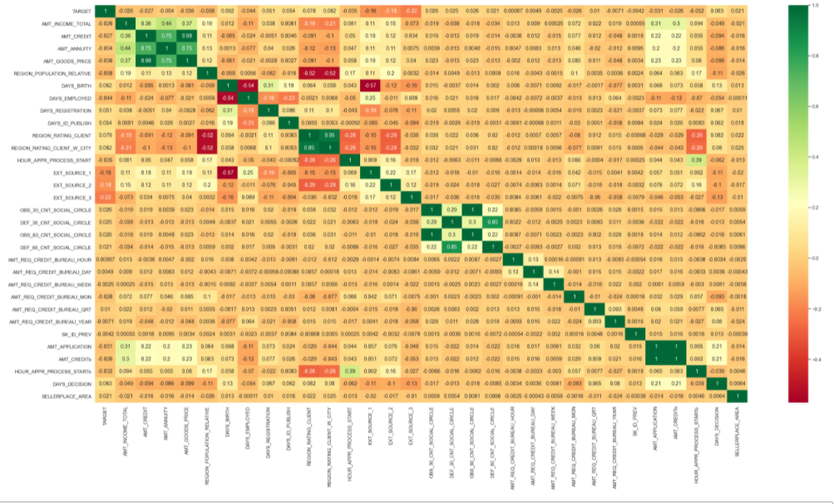
Correlation between variables
Inferences :
From the above correlation we can say that Final credit amount on the previous application(AMT_CREDIT_P) has a high correlation with AMT_APPLICATION , for the amount which client initially applied.
Higher the count of children , less is the years employed.
For consumer loans, higher the price of the goods given in exchange for loan, higher is the loan credited given to the customer
For DAYS employed has a negative correlation between hours application process start from previous data. Faster application process happens when the client is employed for more days.
Higher Number of enquiries to Credit Bureau about the client one day year, higher is the days took for decision.

Slide 18
Conclusion:
As per our observation, loans repayment is most likely to be done without any difficulties for men and women who are of following income range categories: 100000-150000.
Business Entity Type3 has equal chances of being defaulters and non-defaulters.
Working officials, commercial associates and pensioners are the potential customers a bank can give loans to.
People with academic degree has high income compared to other educational background and they tend to default less. Even then married people within academic degree category can become defaulters.

